Slide 1

FIFA Project

Slide 2

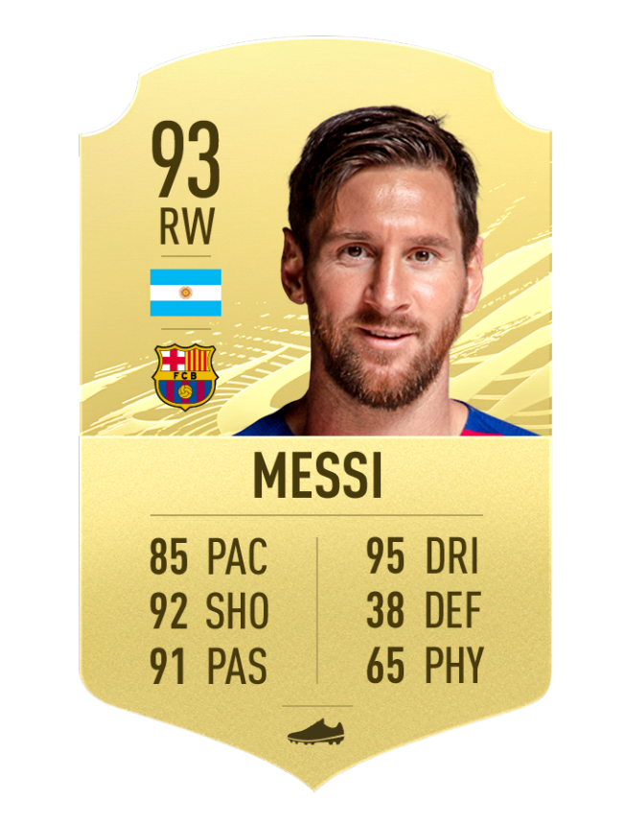
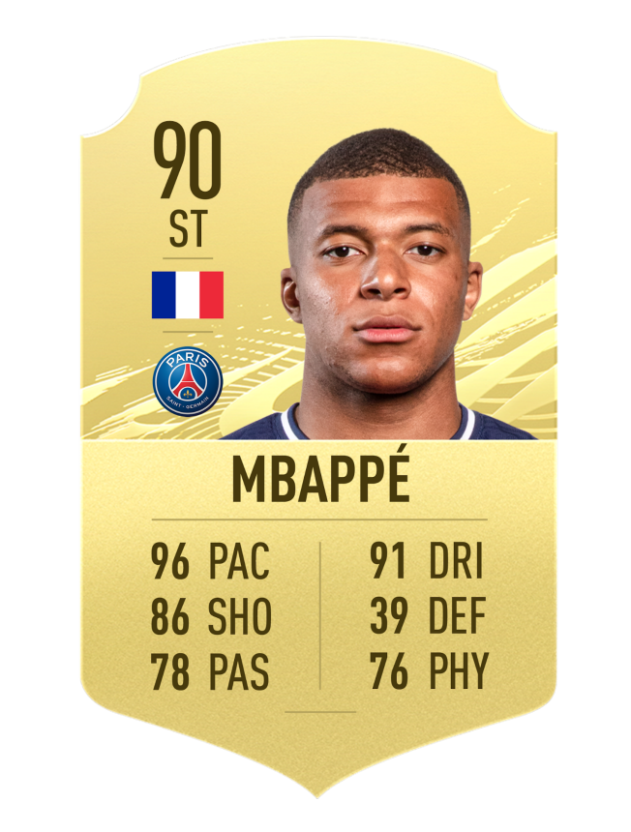
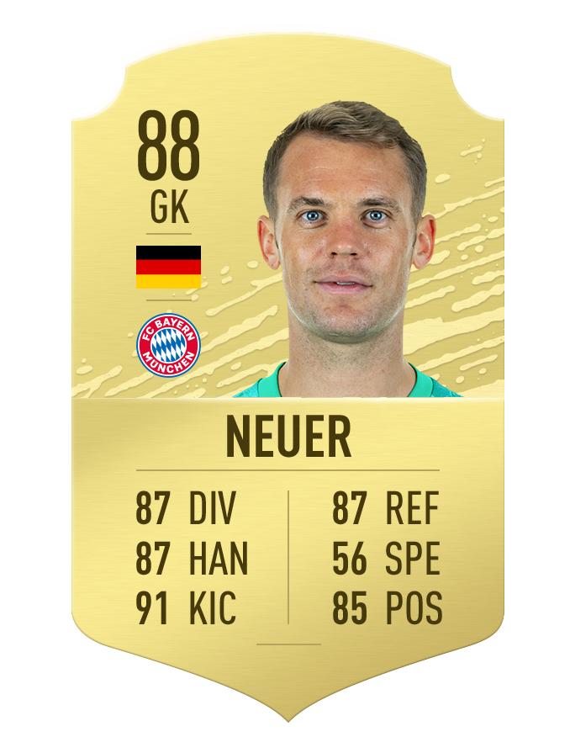
Mission and feature descriptions
The mission: predict the value/wage of FIFA’s players.

Slide 3
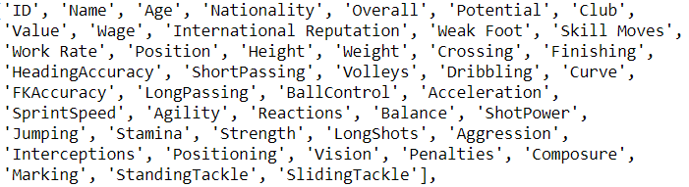
Meet the features
Identification
Y

Slide 4
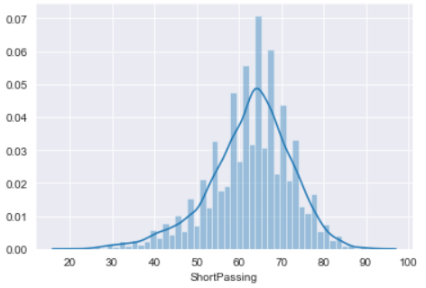
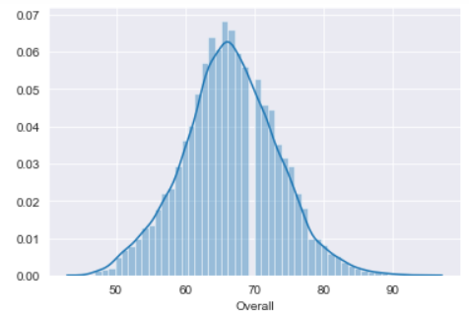
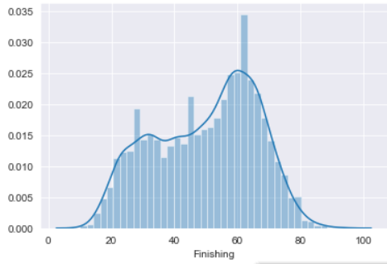
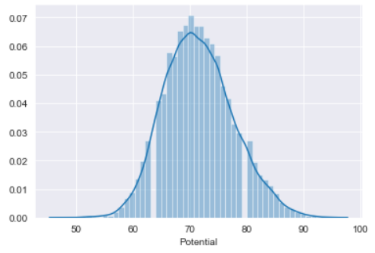
Feature statistics and feature selection

Slide 5
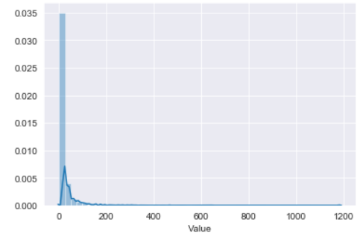
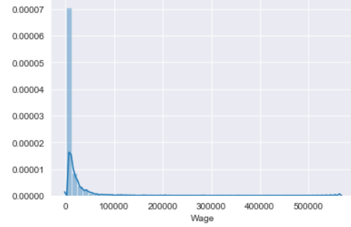
Wage and Value

Slide 6
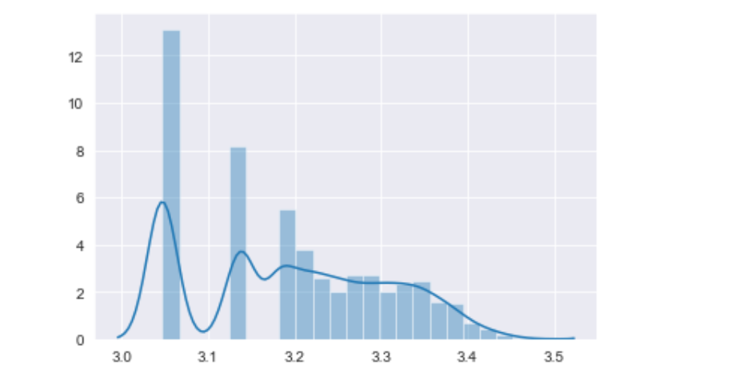
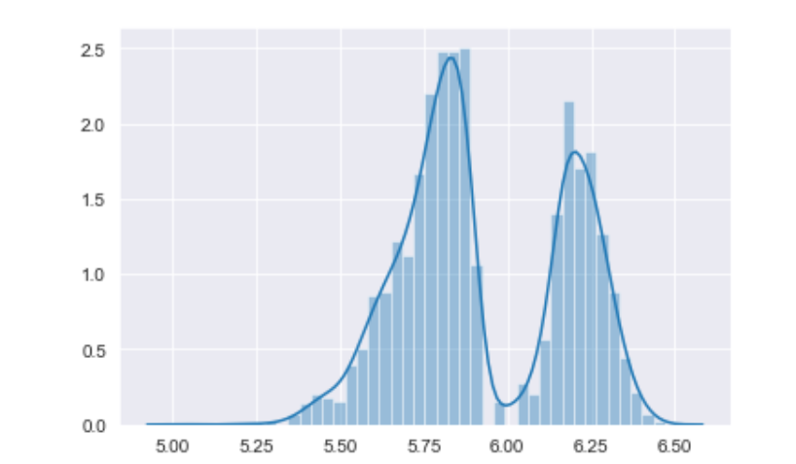
Wage and Value Normalized

Slide 7
Preprocessing
Data organization and feature selection
Treatment of categorical and object variables
Dummy variables
One hot encoding
Features normalized

Slide 8
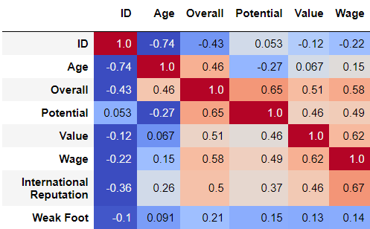
Feature correlation matrix

Slide 9
Hyperparameters tuning
number of neurons: L1=128, L2=128, L3=128, L4=1
number of layers: 4
regularization: L1/L2/Dropout

Slide 10
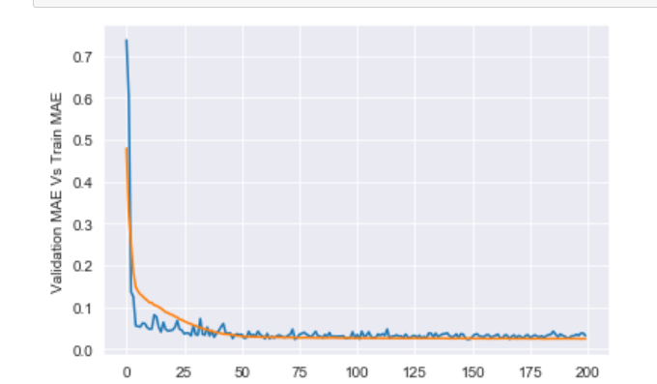
Wage

Slide 11
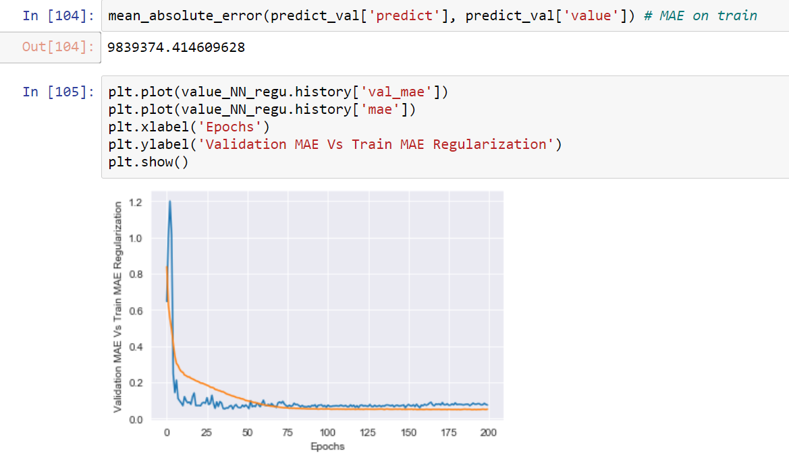
Value

Slide 12
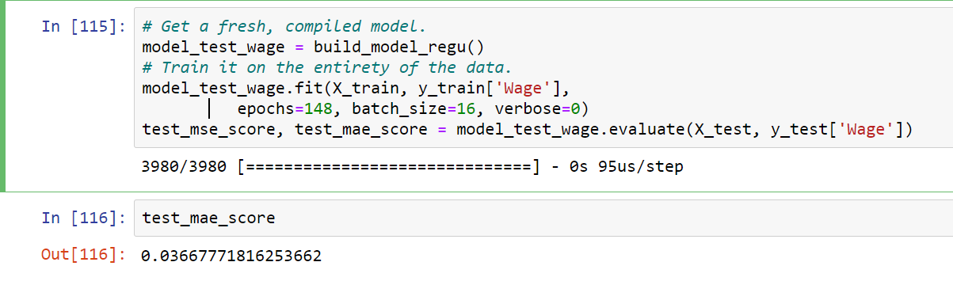
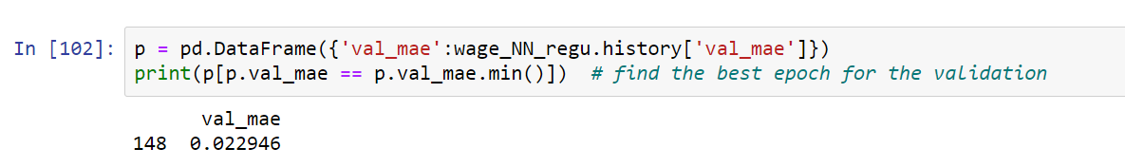
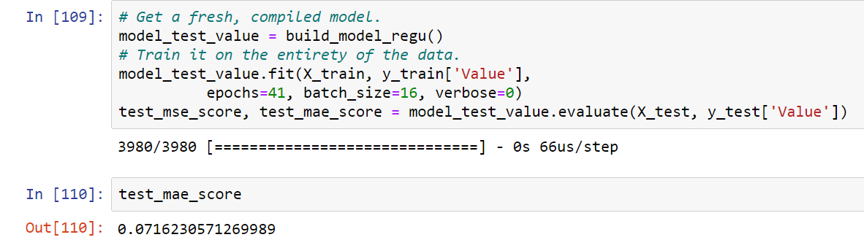
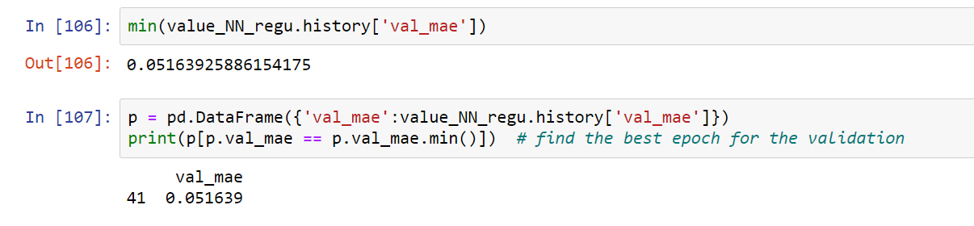
Results analysis
Train results.
Training, validation and Test results.

Slide 13





